Slide 1
Any Boson at Home?
ButterGods
Blai Ras, Pablo Álvarez, David Vilà, Àlex Padrós and Andreu Orós

Slide 2
Data preprocessing
We normalized all the data
StandarScaler()
RobustScaler(): takes into account outliers.
We looked at correlations
We removed BUTTER
We tried to train removing variables with some correlation

Slide 3
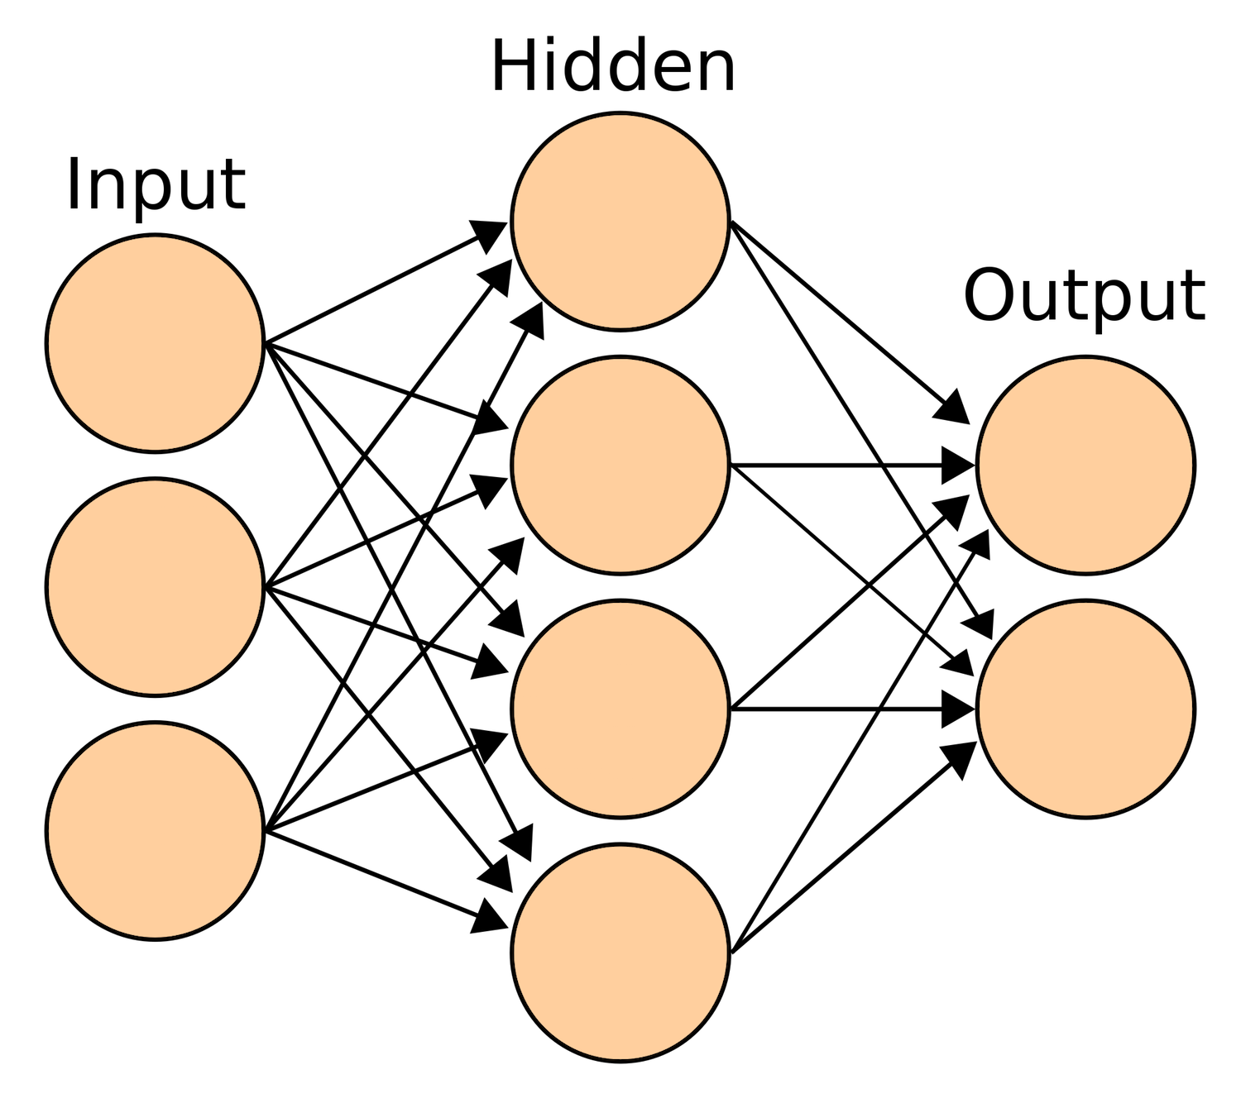
Best model: MLP Classifier
Grid-Search CV for select hyperparameters
Multi-Layer Perceptron
Activation: tanh
Alpha: 0.001 (L-2 regularization)
5 hidden layers of size 100
Early-Stopping: True, max. 5 iteration with no improvement

Slide 4
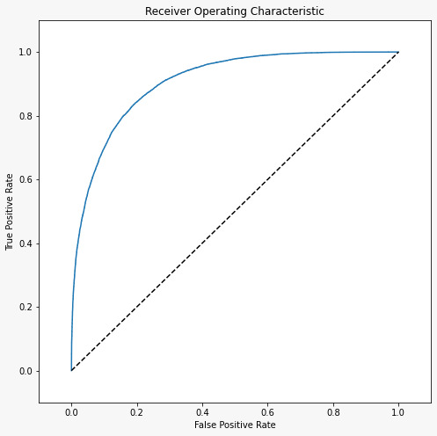
Results
Train AUC Score 0.90588
Test AUC Score: 0.90691
Kaggle AUC Score:
Public: 0.91572
Private 0,91294

